Slide 1
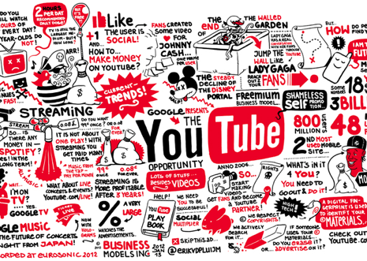
Strategies to be a Successful YouTuber
DATS 6401 – Final Project – Vishnupriya Venkateswaran

Slide 2

Overview
Introduction
Background of dataset
Data Preprocessing
Exploratory Data Analysis
Proposed Visualization
YouTube in USA
YouTube in Other Countries
Prediction and Forecasting
Conclusions
Tools and Packages
References

Slide 3

Introduction
YouTube has developed into a successful platform for user-generated content
YouTube has transformed from a video sharing site into a job opportunity for content creators
YouTube is now one of the major social network platforms like Facebook, Instagram, and Twitter. It is now a rising search engine for all topics a user is interested.
With over millions of subscribers, YouTube stars make profits not only by the views but also by launching their own business on the YouTube platform. This project focuses on the strategies a YouTuber has to take to become successful.

Slide 4
Background of Datasets
YouTube maintains a list of top trending videos on its site. The data is recorded daily and is available on Kaggle. This dataset includes several months of data on daily trending YouTube videos. Data is available for USA, Great Britain, Germany, Canada, and France with up to 200 listed trending videos per day collected over many months.
YouTube-8M is a large-scale labeled video dataset that consists of millions of YouTube video IDs.
YouTube API – from which list of subscribers for each channel can be scraped.

Slide 5
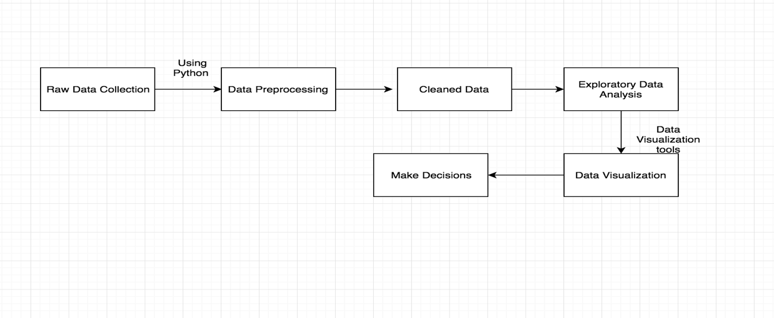
System Architecture and design

Slide 6
Data Preprocessing
The initial step was reading data from the source and creating a dataset with column names in a more readable form.
Then the data is cleaned and pre-processed using python. The data contained many blanks and NAN values and redundant data which was removed using pandas.
Some data files are csv files and some are in json file format.

Slide 7
Exploratory Data Analysis
EDA is done for all countries by finding the descriptive statistics for all variables.
Describing every feature in the datasets
Developing questions for analysis

Slide 8
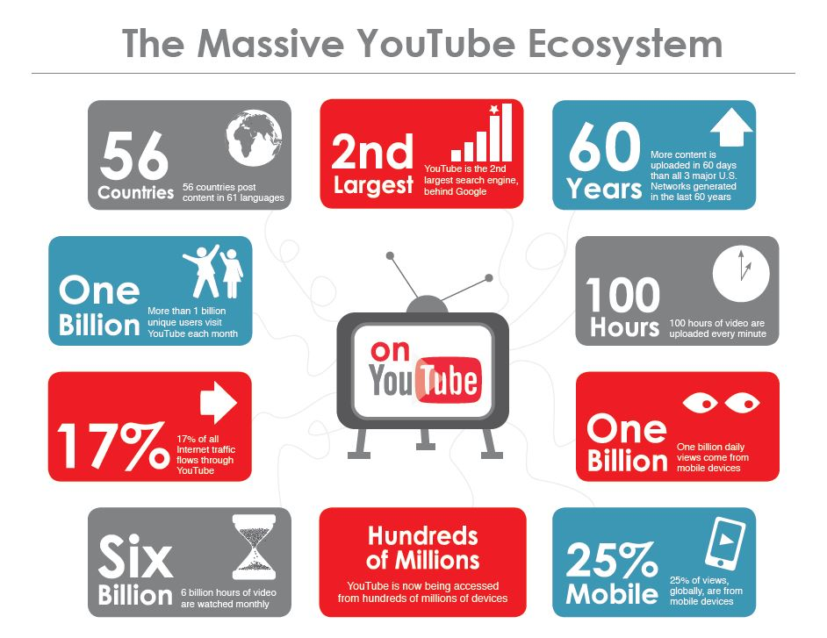
About YouTube

Slide 9


Analysis

Slide 10
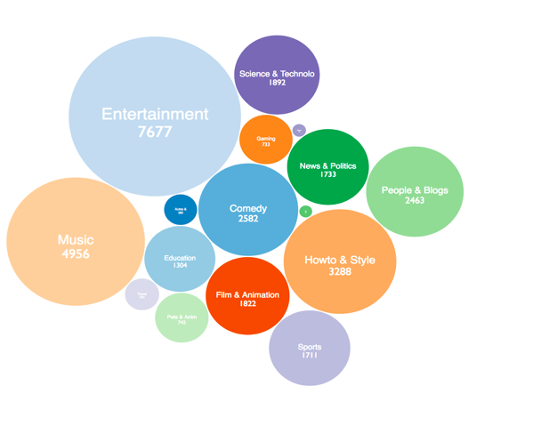
Different Categories of Videos in YouTube
The different categories are calculated with counting unique video id’s.
There are 16 types of video topics, This was obtained by counting the number of videos and channels under each topic.
Entertainment is at the hottest category on YouTube.
Music, People & Blog, Howto & Style, and Science & Technology have a large number of channels.

Slide 11
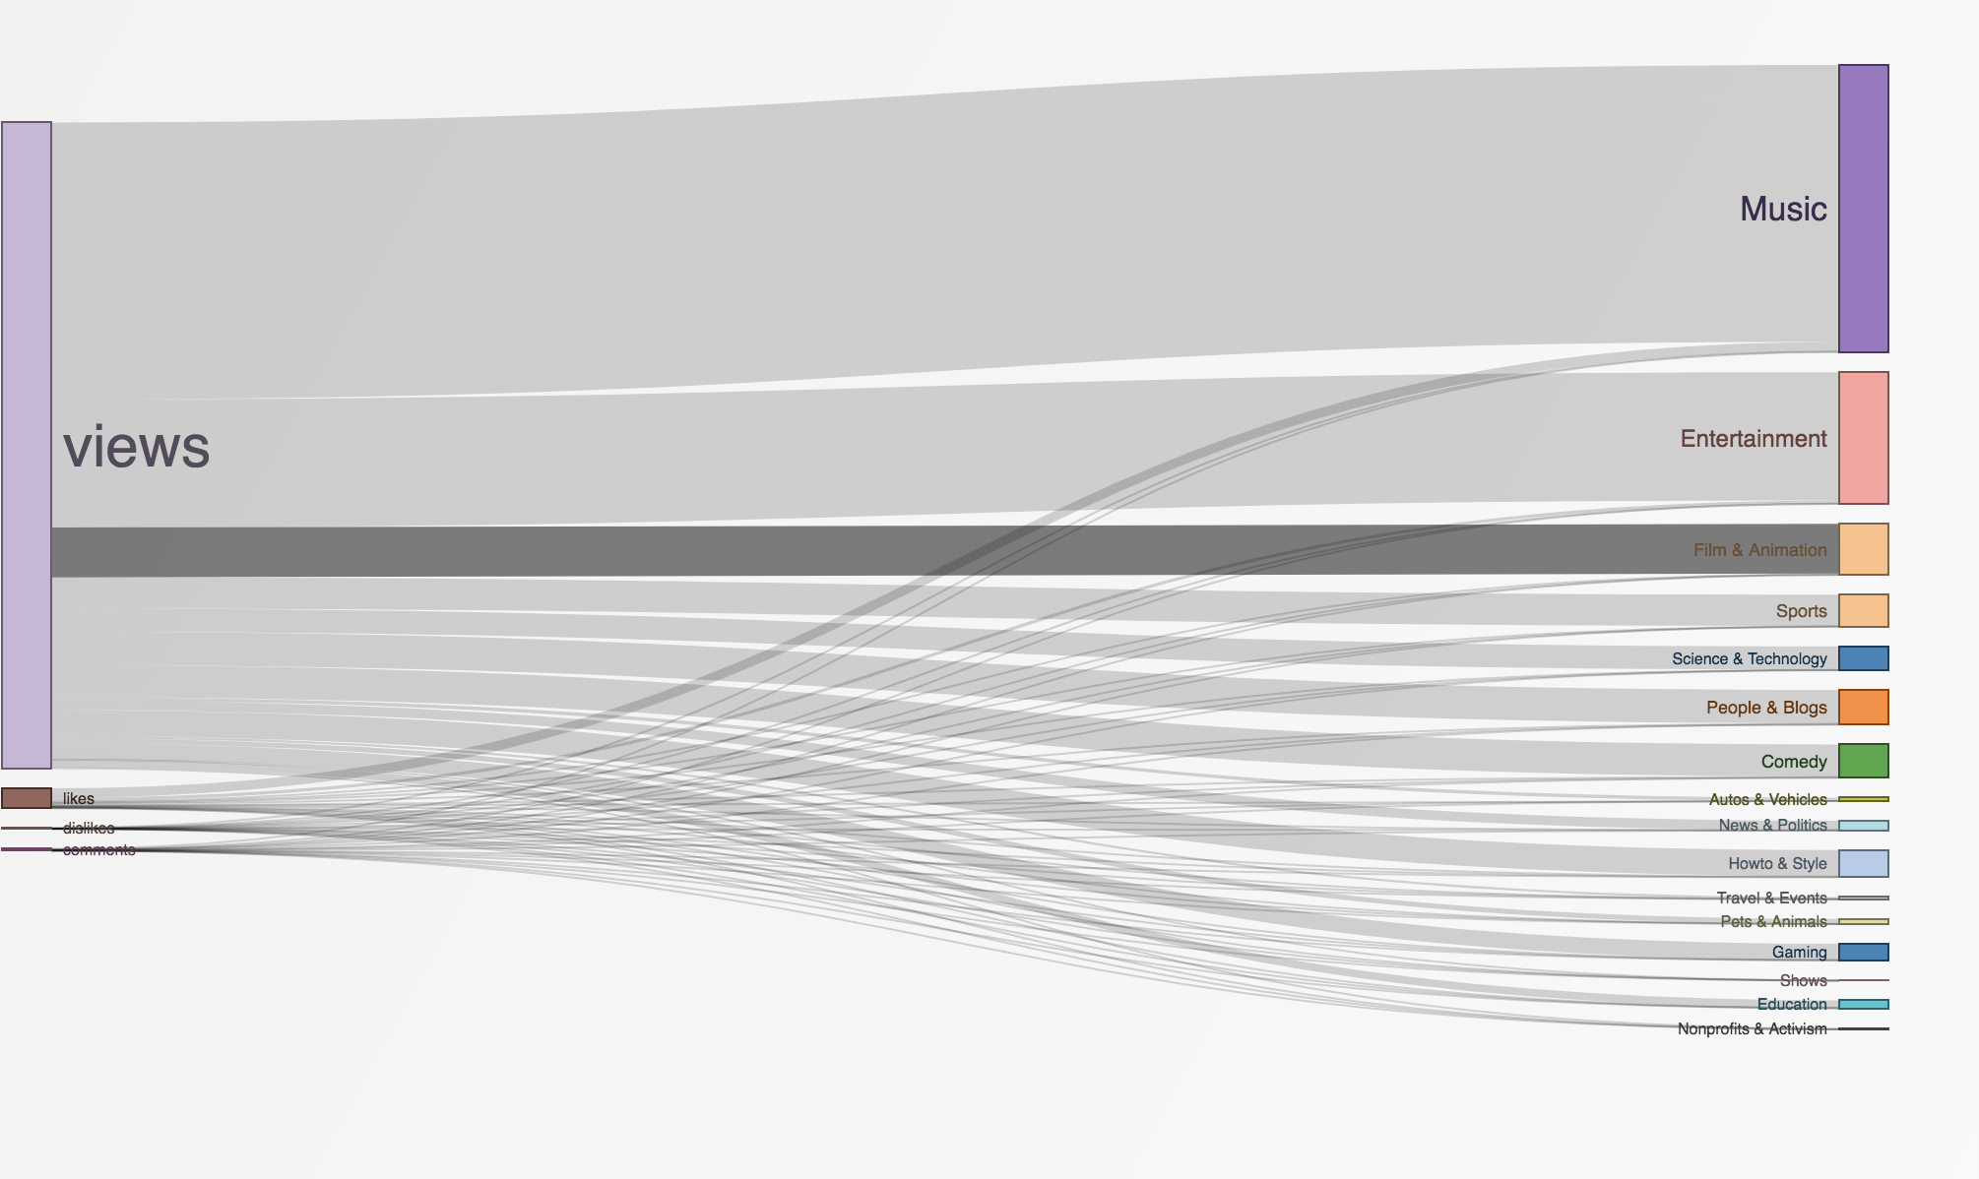
Important factors to determine success of a video
The most important factors that determine the success of a video are the views, the likes, dislikes and comments
The above visualization is a Sankey diagram which is a specific type of flow diagram, in which the width of the arrows is shown proportionally to the flow quantity.
The views seem to play a vital role in determining the success of a video.
The chart shows the number of views, likes, dislikes and comments for each category of YouTube video

Slide 12
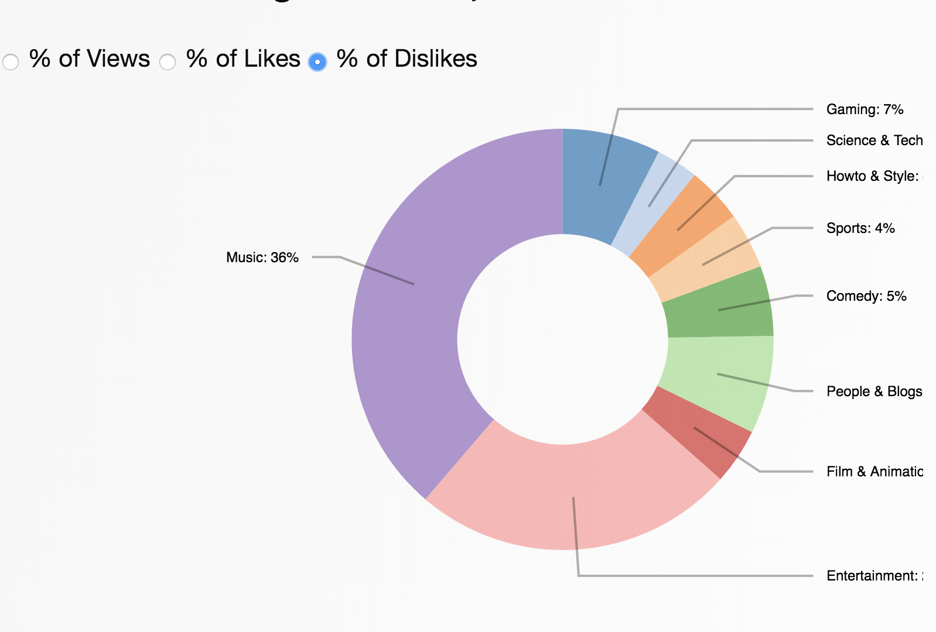
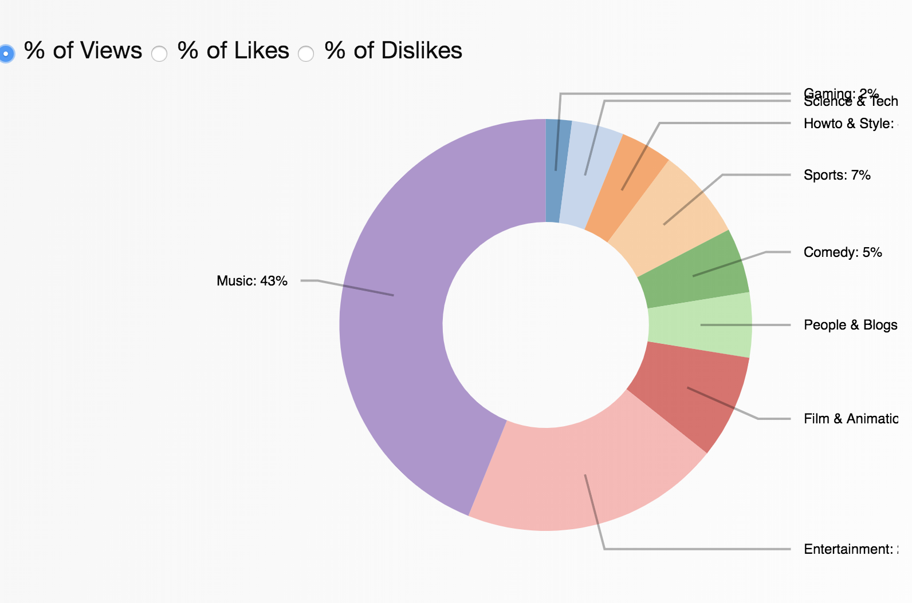
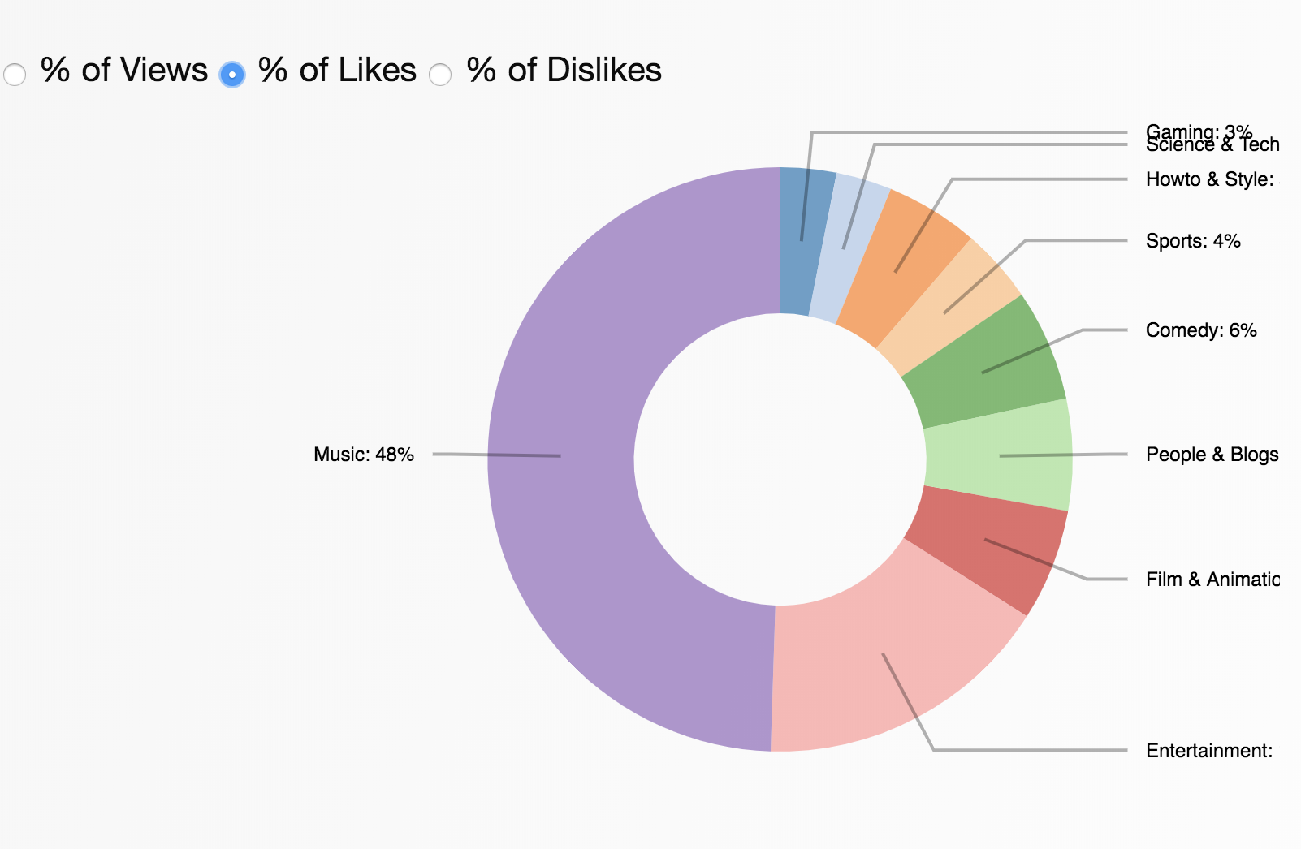
Percentage of Views, Likes and Dislikes
The best ratio for measuring success is by getting the Percentage of Views, Likes and Dislikes.
The pie chart shows Views, Likes and Dislikes as a percentage in each category of YouTube video.

Slide 13
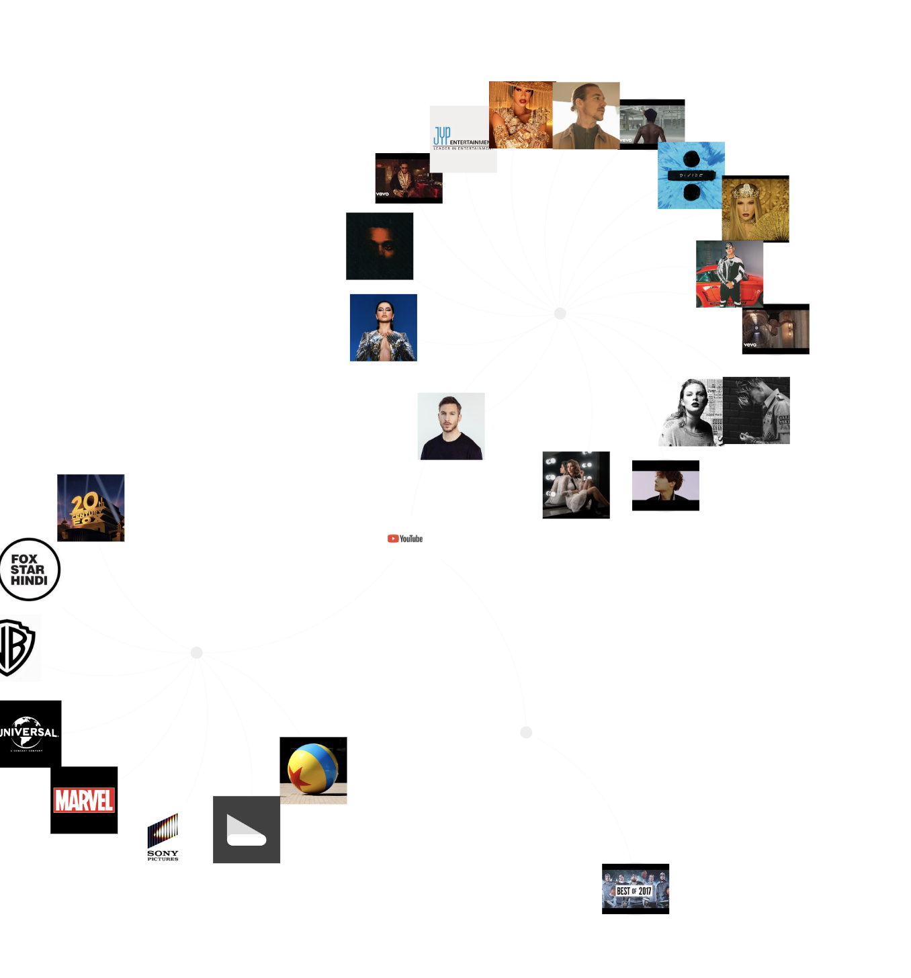
Biggest YouTube Channels in USA
Each node in the chart contains an image and link to the top 25 channels on YouTube in USA.
These channels are categorized according to the video category.
The biggest channels on YouTube belong to Music, Entertainment and Sports.
On clicking the image a link to their respective YouTube channel is generated.
These channels are calculated by the number of subscribers and the number of viewers and like they have on their videos.

Slide 14
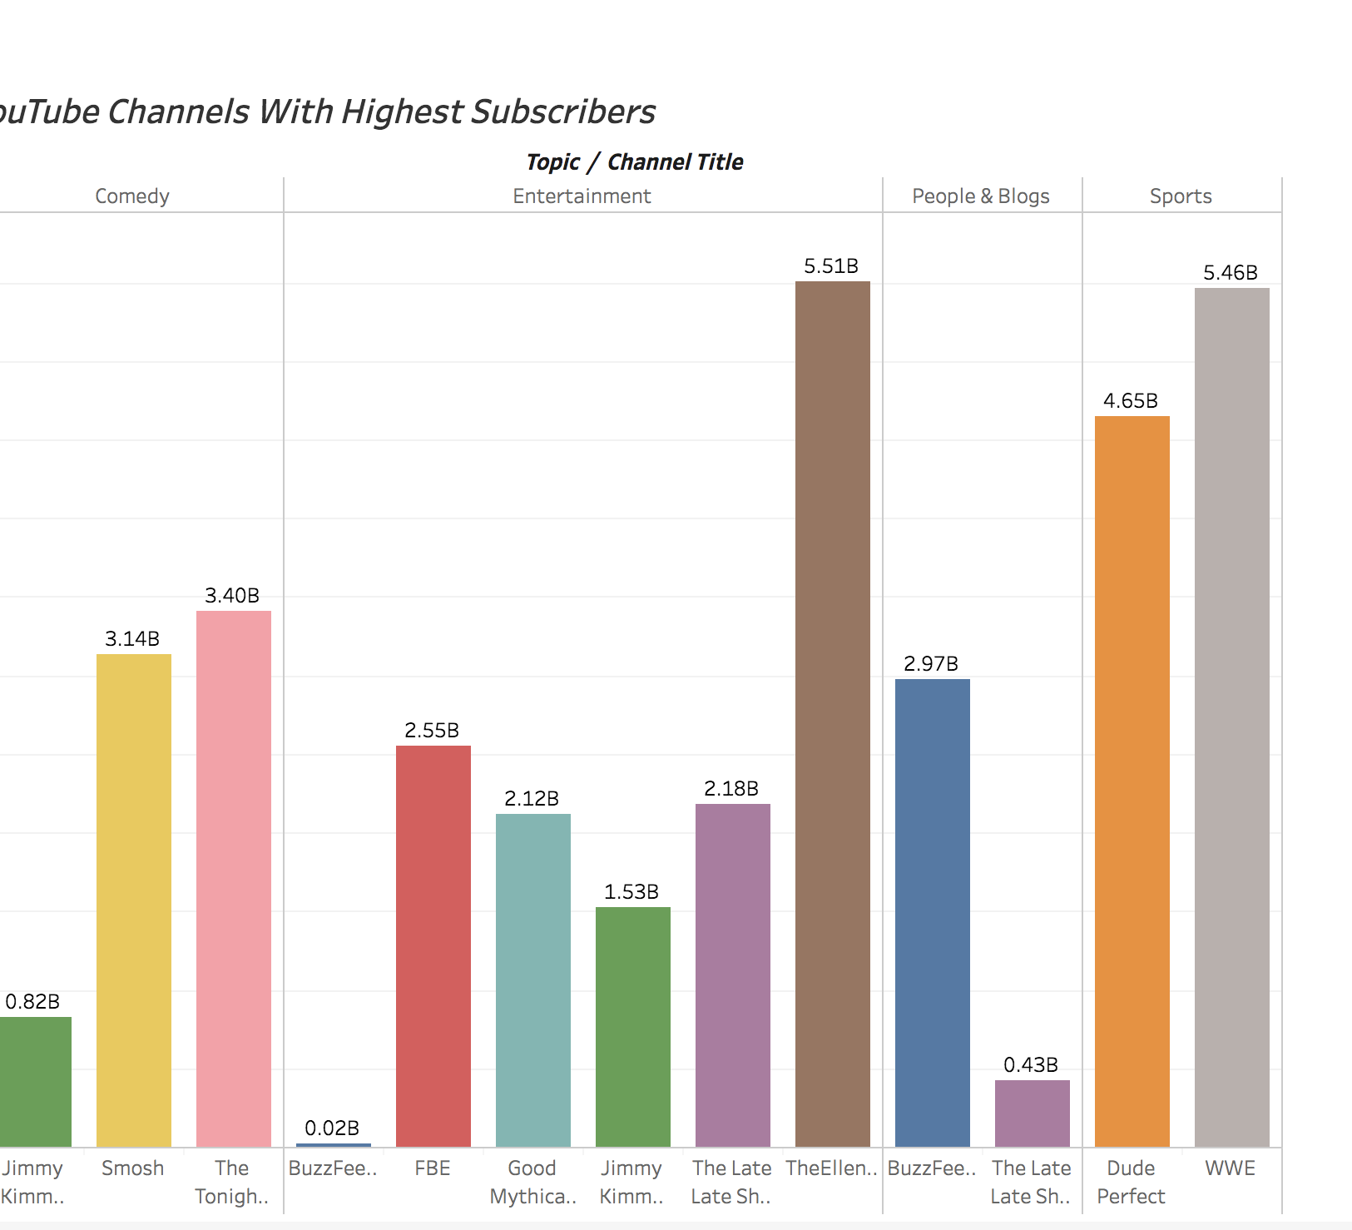
YouTube channels with highest number of Subscribers
The number of subscribers can be calculated by scaring data from the YouTube API.
The highest number of subscribers a channel has is 5.51 Billion which is for The Ellen Show under Entertainment.
The second highest subscribers for a channel is WWE which is under Sports.
The visualization shows the channels with highest number of subscribers on YouTube.

Slide 15
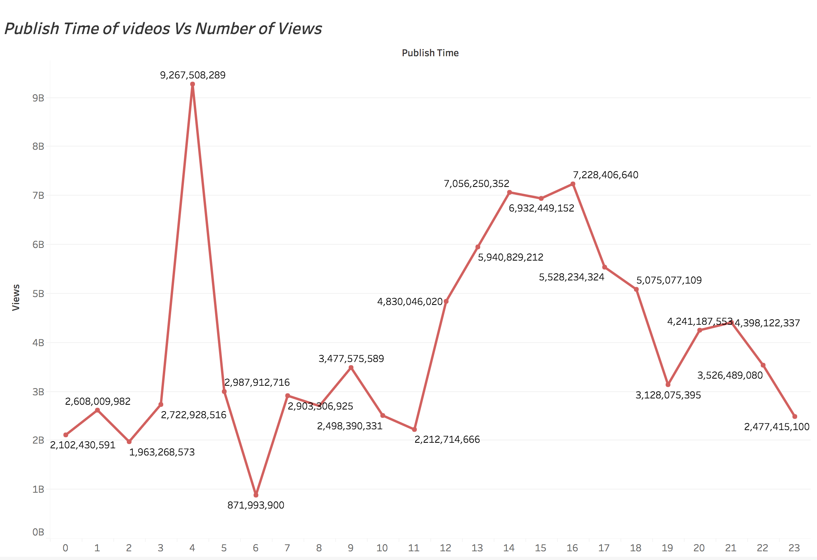
Does Publish Time have an Impact on the success of a video ?
To find out if the publish time plays a role in video success, I plotted a graph on publish time of video for every hour of the day.
Surprising, a video published at 4am got the maximum number of views. And a video published at 6am got the least number of views.

Slide 16
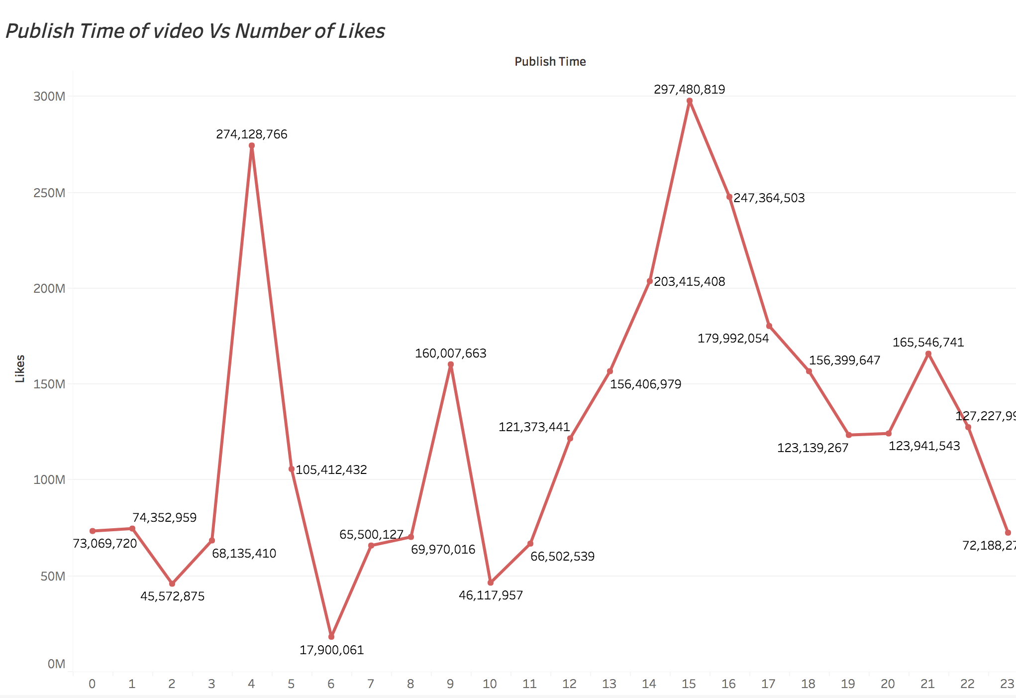
To study the number of likes on each video.
I plotted a time graph with the publish time of video over the likes it received every hour.
The most amount of likes received were for the videos published at 3pm, followed by the videos published at 4am.
The least number of likes were for the videos published at 6am.

Slide 17
Trending days
To find the number of days a video is trending I used the top 10 videos that were trending for the maximum number of days.
The highest number of days a video trends is for 30 days.

Slide 18
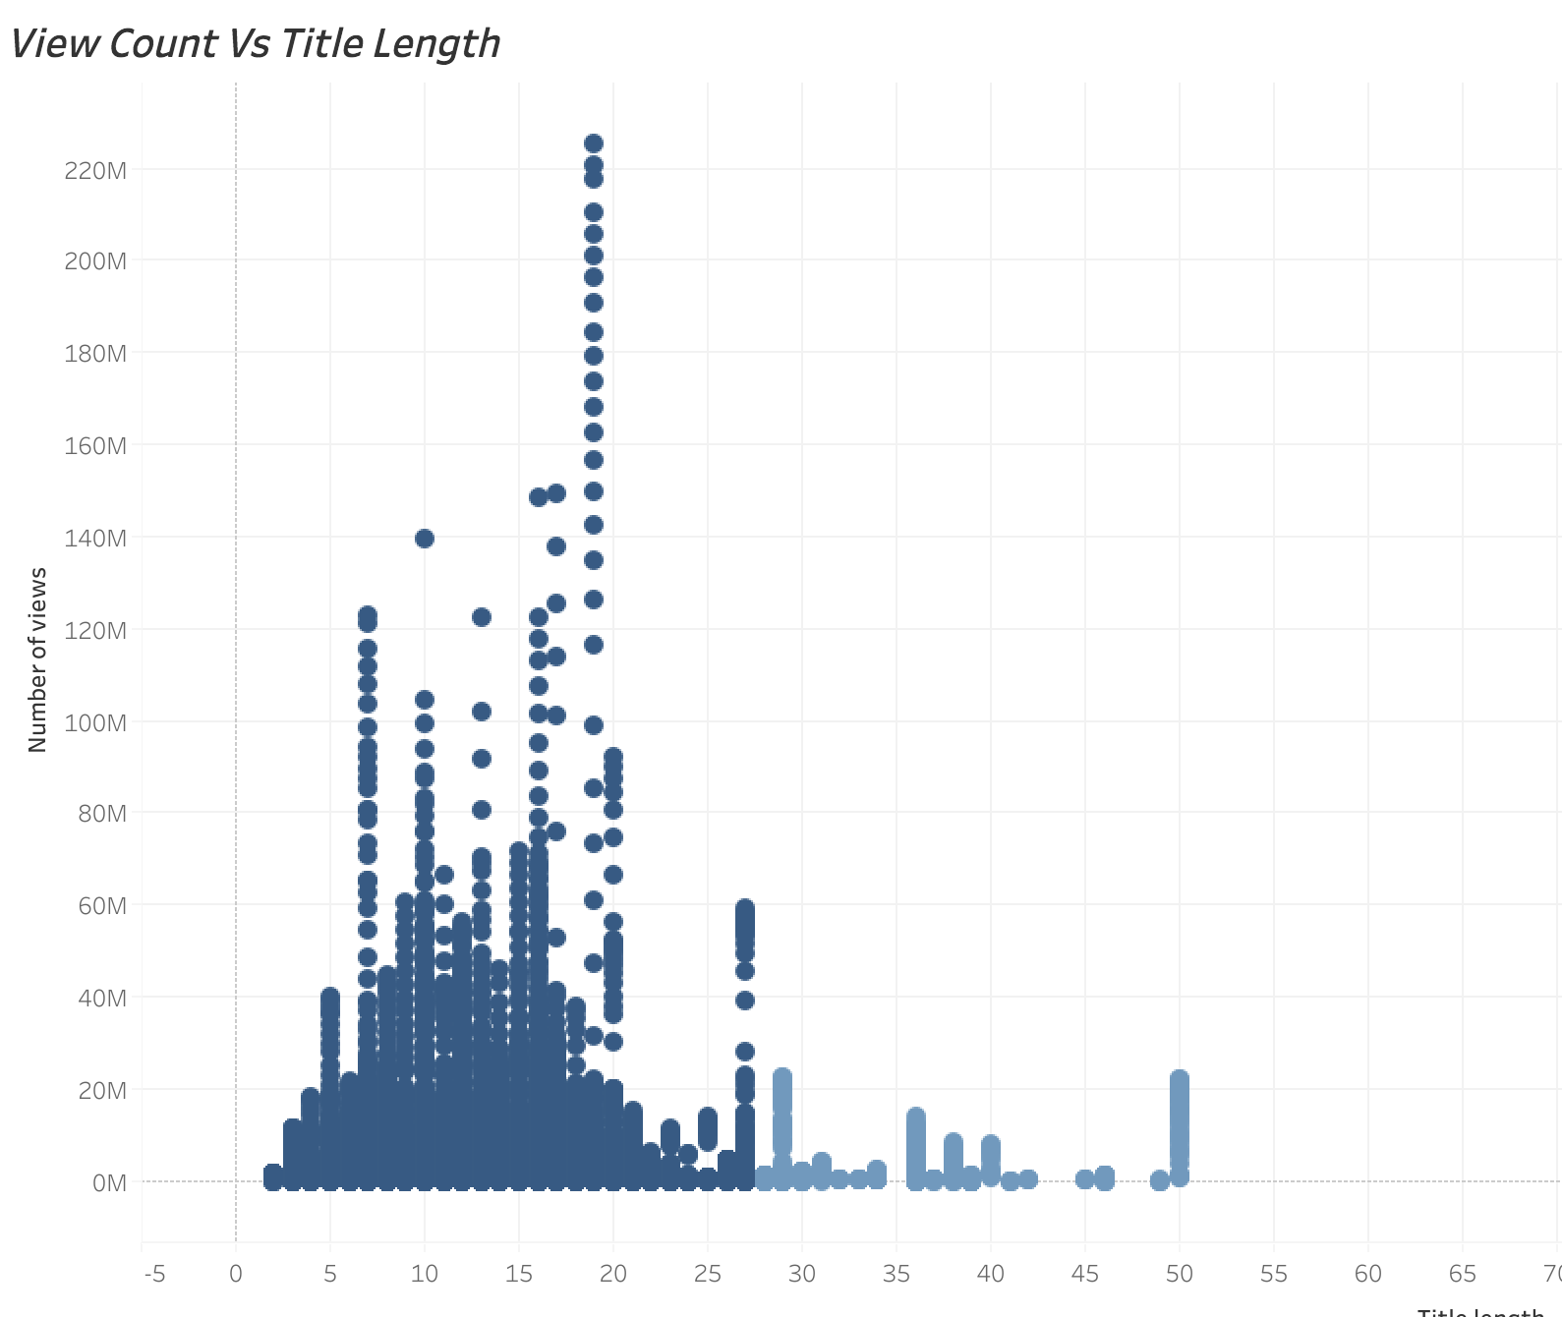
What title is suggested to get attention?
There is a limitation in our perception when we give a glimpse to text. So the length of the title and the number of words in titles are important factors for eye-catching. Does the title length have an effect on the views? How many words are adequate to be contained in titles?
This can be answered by the visualization.
The titles of the videos have less than 100 characters and the views get the highest around 30 and 50 characters. If we say a single word commonly has 5 or 6 characters, this means 5 to 10 words are preferable in the title. The number of words is less than 20 and the views are highest at around 19. Therefore a title with 10 to 15 words is appropriate to get more views.

Slide 19
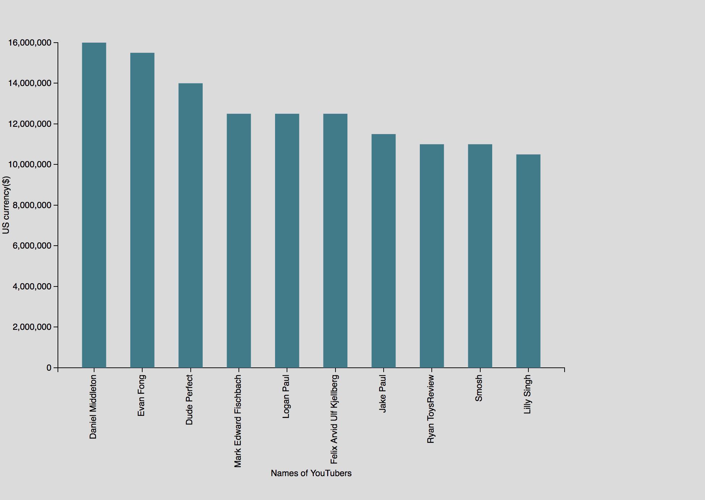
Richest YouTubers in 2018
YouTuber’s make a lot of money. The visualization shows the Top 10 highest earning YouTubers in 2018.
They have millions of followers and get paid thousands of dollars to upload new content often.
The highest paid Youtuber is Daniel Middleton who has about 19million subscribers.

Slide 20
YouTube in other countries
The countries considered are Canada, Germany, France and UK.
In each country the number of videos in each category is calculated.
The most popular topics are determined in each country.

Slide 21
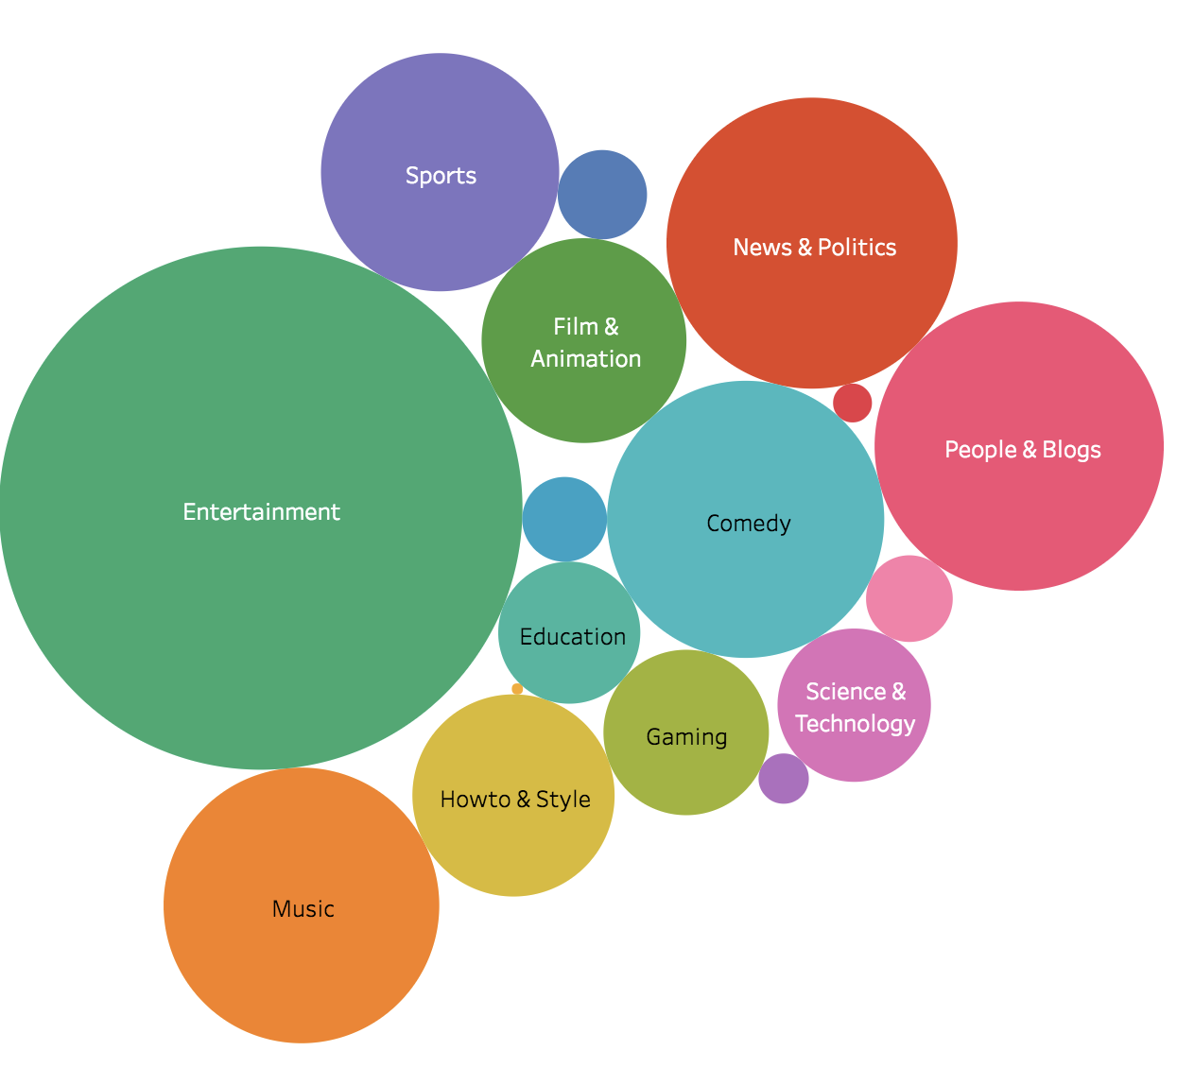
Canada
In Canada, the most popular topic is Entertainment.
News and Politics and Vlogs are the second most popular category.

Slide 22
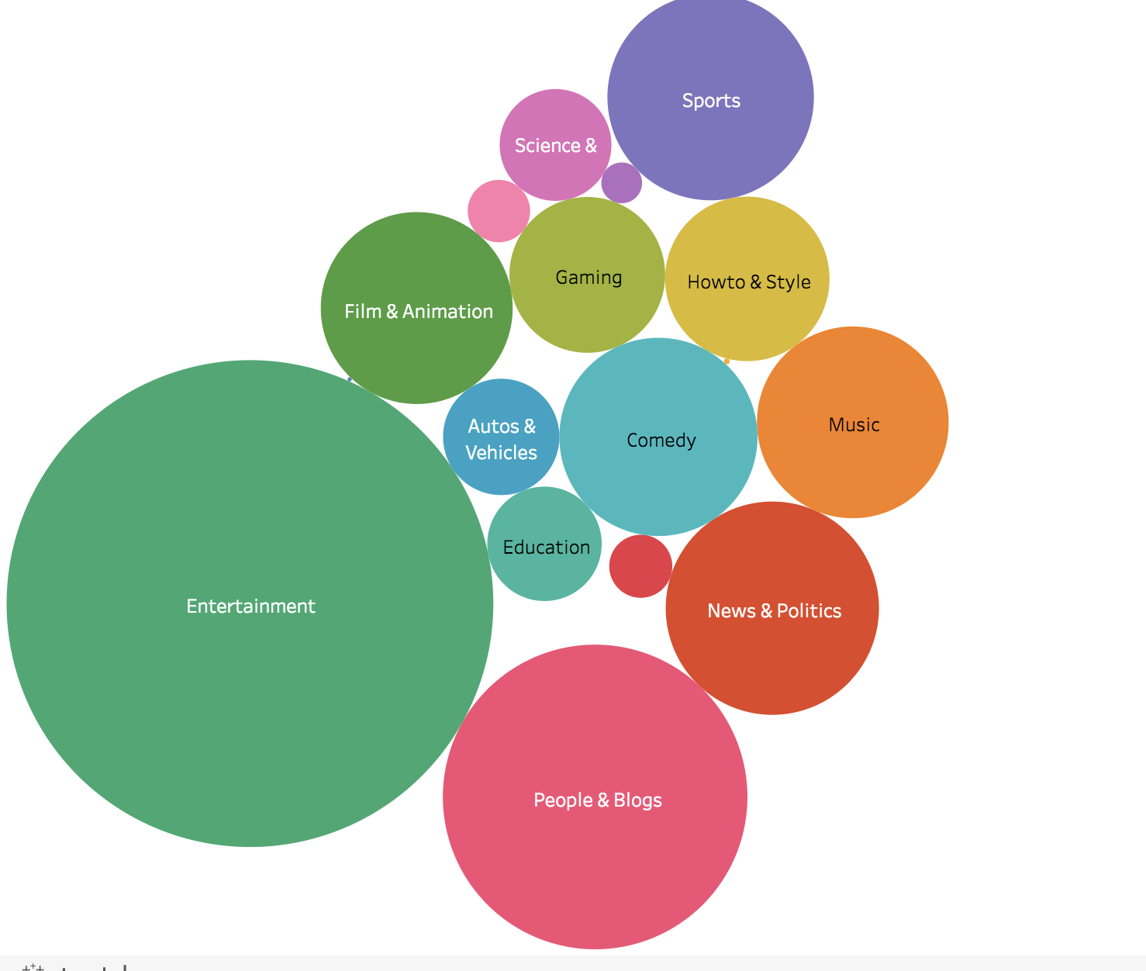
Germany
Entertainment is the most popular video category in Germany.
The second most popular category is People and Blogs.

Slide 23
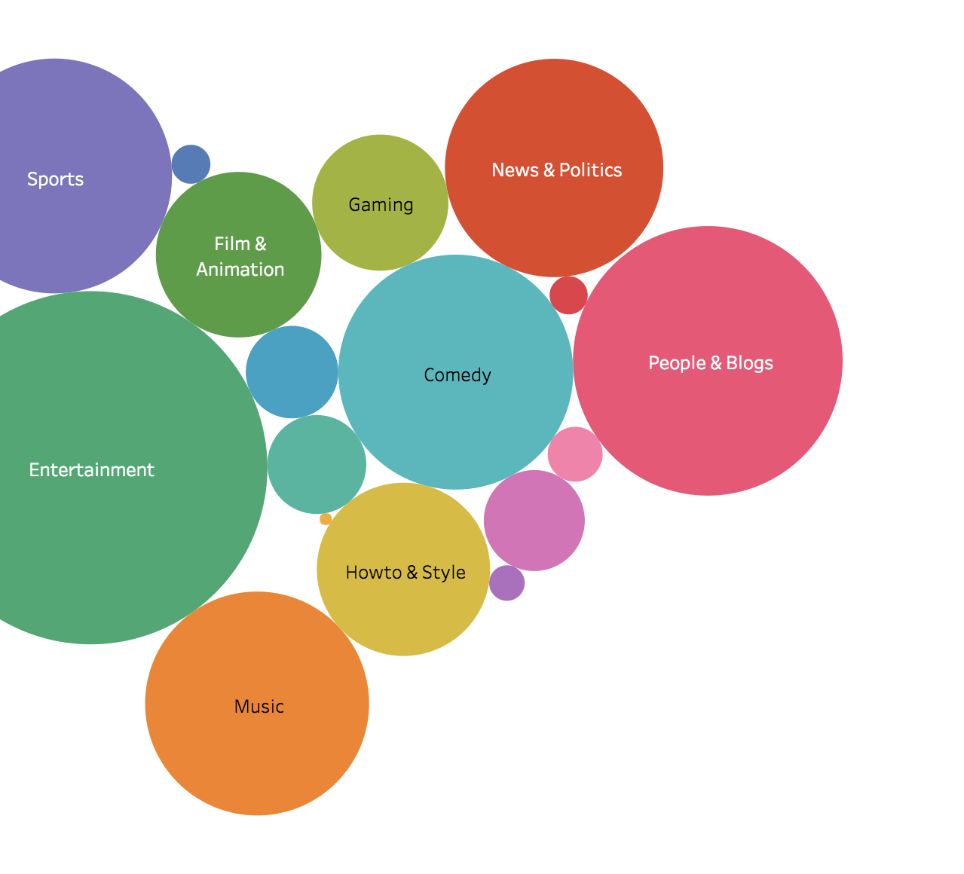
France
In France, Blogs and politics are equally as popular as Entertainment.

Slide 24
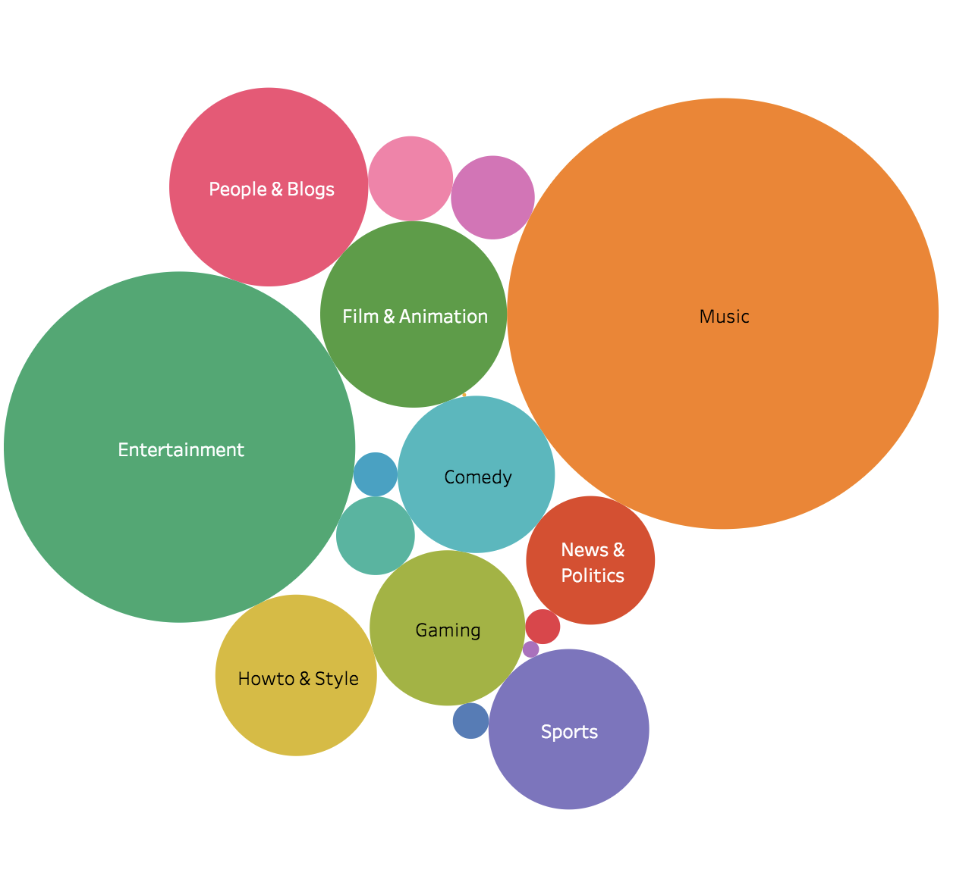
UK
In UK, music is the most popular topic.

Slide 25
Prediction and Forecasting
If a YouTuber makes a video which is in Entertainment category or Music the video is likely to be successful on YouTube
Games, and interactive experiences will grow in the YouTube community. In both cases partly driven by YouTube’s evolution into the world’s largest catalogue of virtual reality content. But also because games will sit neatly alongside shows and music in YouTube’s entertainment mix. In future, YouTube will be a main source of income for many content makers.
Today’s YouTubers will be tomorrow’s moguls
In 2014, YouTube’s biggest star PewDiePie generated 4.1bn views from his channel. Where will he be in 2025? Quite likely running one of the world’s biggest entertainment networks.
By 2025, though, live sports will be a key part of YouTube’s video offering.

Slide 26
Conclusion
The number of videos and subscribers is used in evaluating hotness and competitiveness of videos.
The quickest response rate can be used when it’s considered with the number of likes, dislikes, and comments.
Title phrasing is essential, to get more views.
Therefore, to be a successful YouTuber, having millions of subscribers is significant.
However, making videos that contains what people care about is as much important as the numbers.
From the analysis and trends, we can figure out what people are interested in watching and how one can brand a company based on these trends.

Slide 27
Tools and Packages
The development platforms used in this project are:
Python – Used for data preprocessing.
HTML, JavaScript, and CSS – Used to build web pages to showcase all the analysis.
Tableau – Visualization tool used to see and understand the data.
D3.js – JavaScript library used for providing dynamic, interactive data visualizations.

Slide 28
References
Youtube API - https://developers.google.com/youtube/v3/
Social Blade - https://socialblade.com/
YouTube 8M - https://research.google.com/youtube8m/index.html
Kaggle - https://www.kaggle.com/datasnaek/youtube-new

Slide 29


THANK YOU !

